Slide 1




PEOPLE’S COMMITTEE OF TAN BINH DISTRICT
CHI LANG PRIMARY SCHOOL
Grade: 2
UNIT 5: FREE TIME ACTIVITIES (review)
Teacher: Hoàng Thị Thanh Thảo

Slide 2

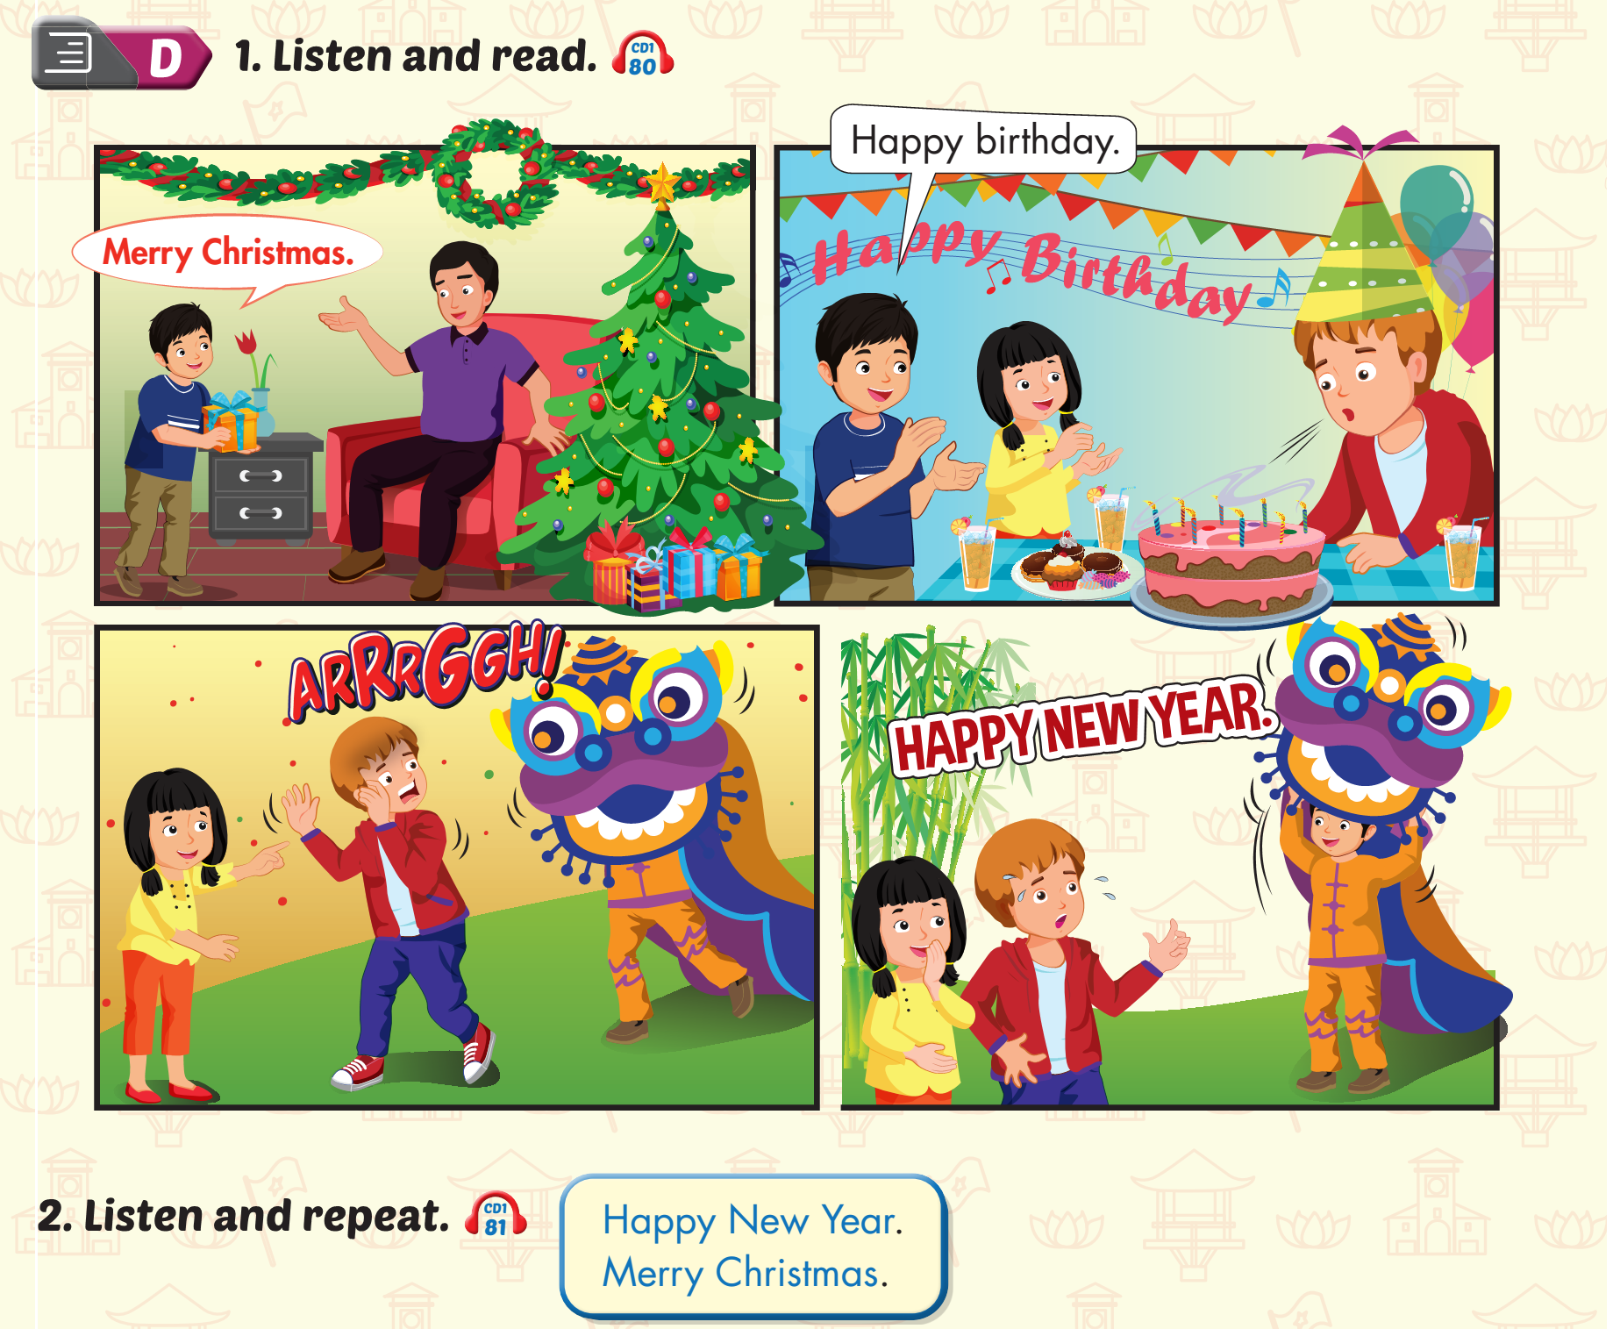
Lesson 3

Slide 3
Lesson 3

Slide 4
Lesson 3

Slide 5
1
2
3

Slide 6
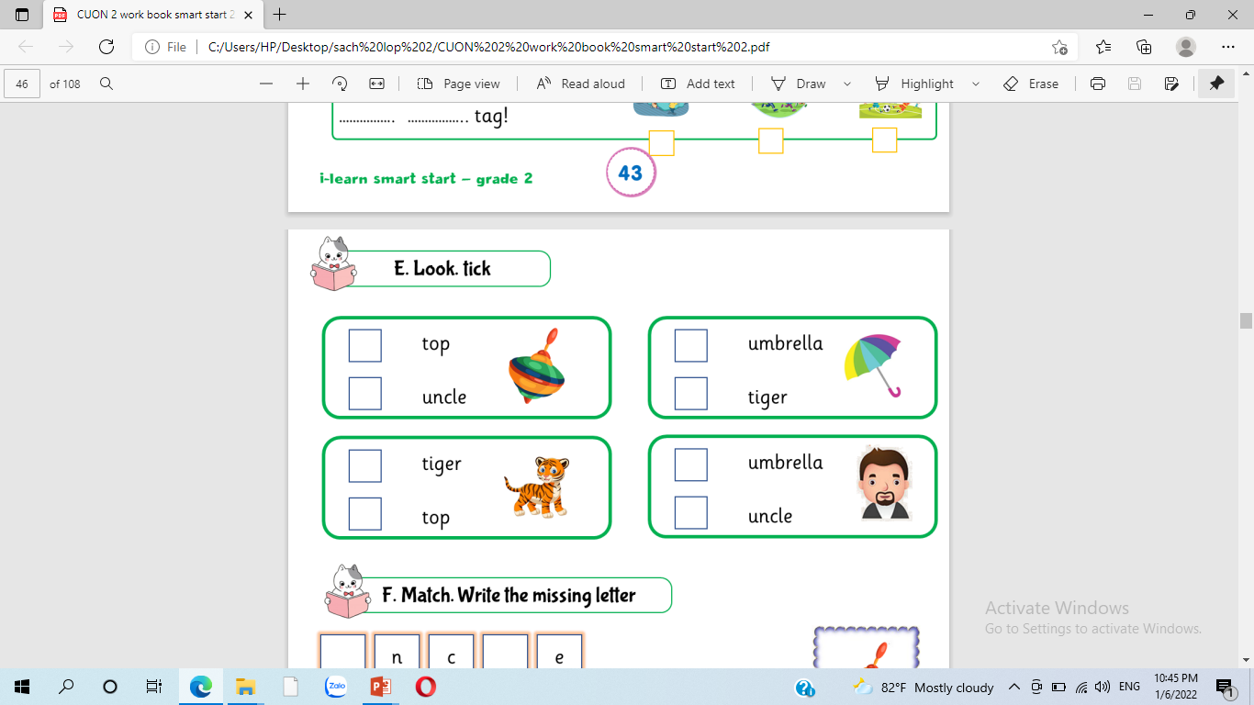

Slide 10
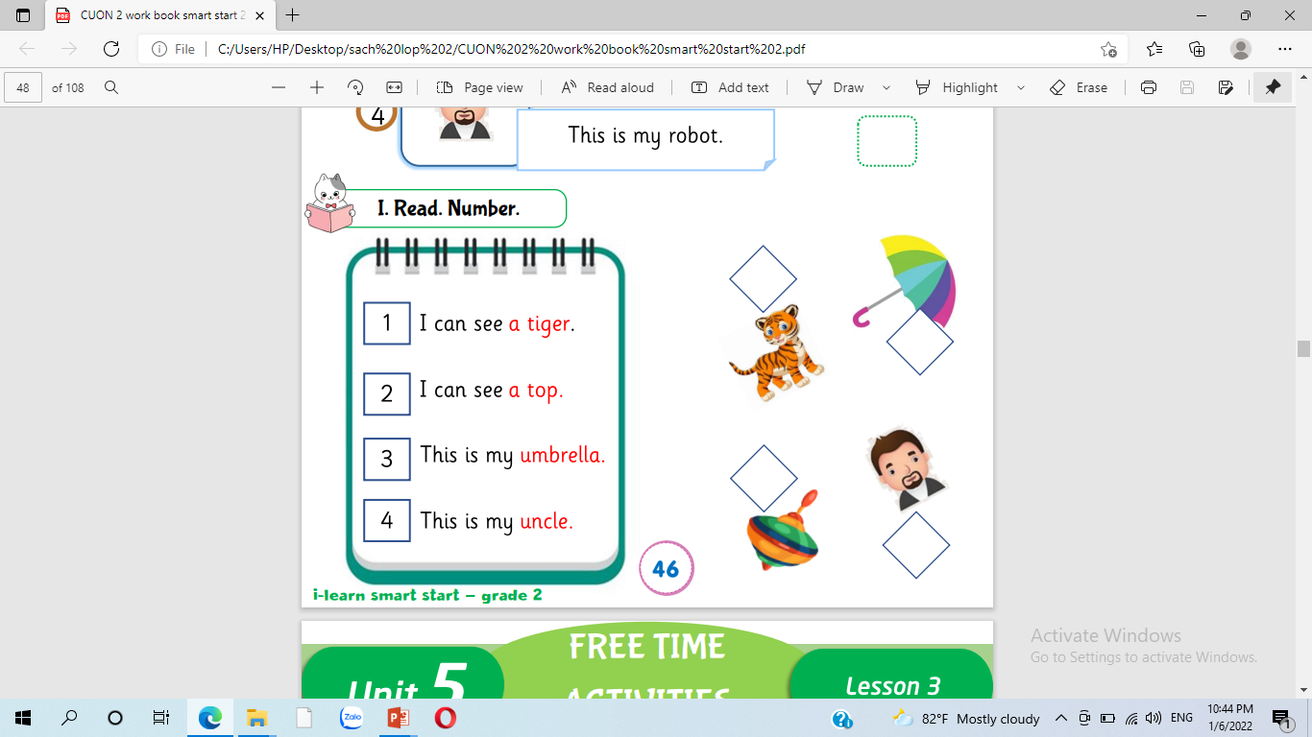

Slide 14
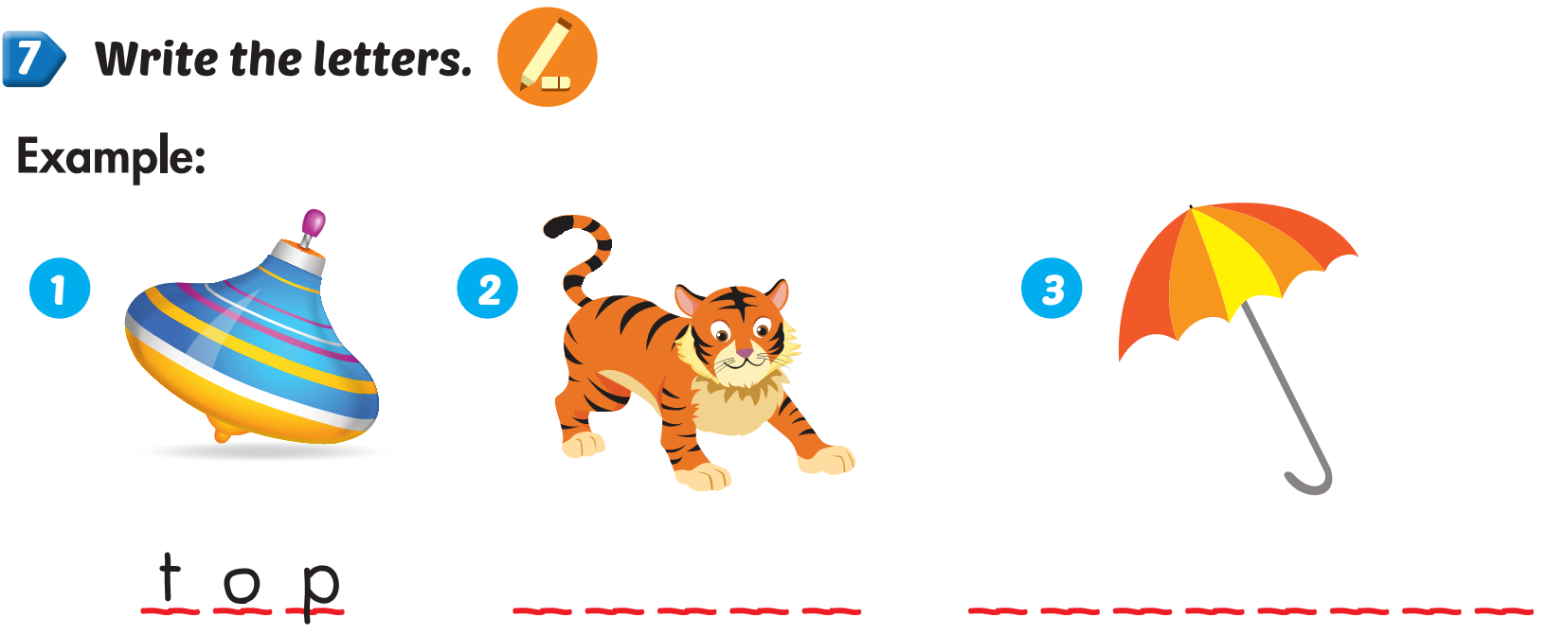
Lesson 2

Slide 15
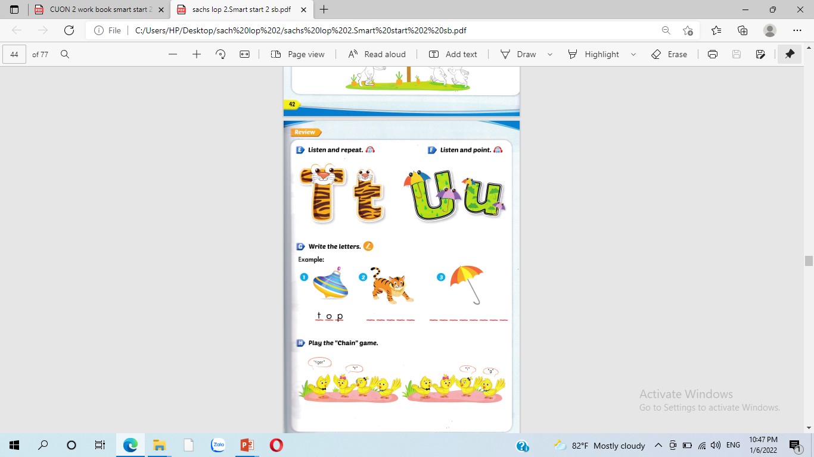

Slide 16
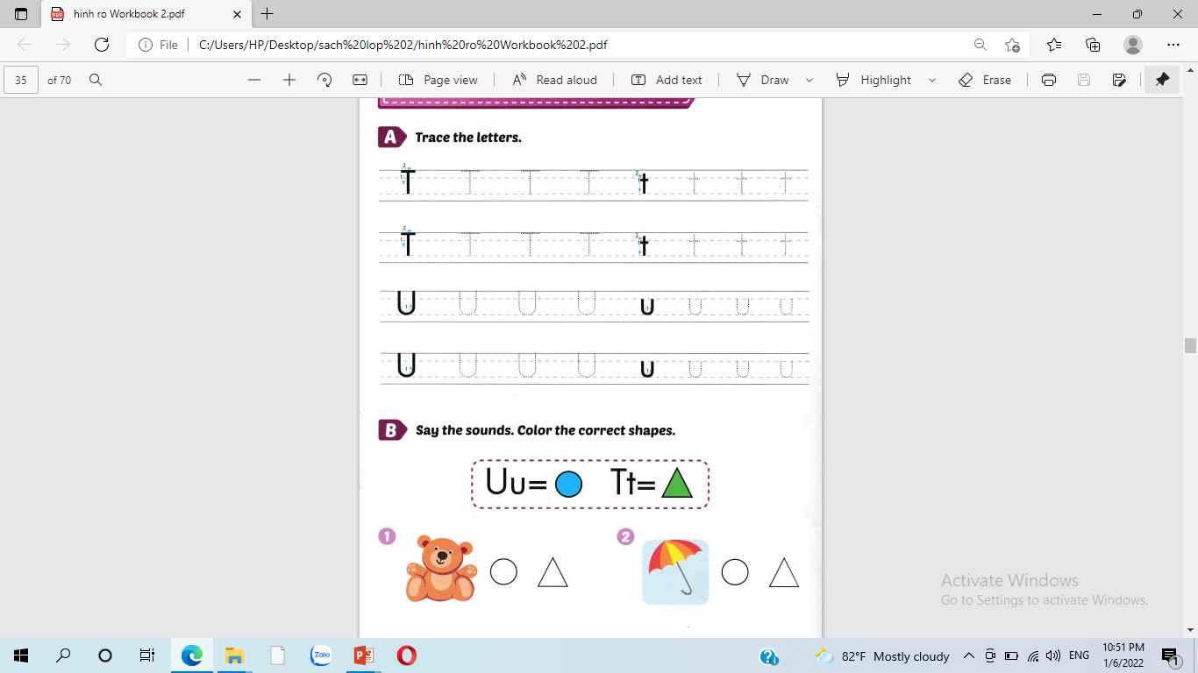

Slide 18
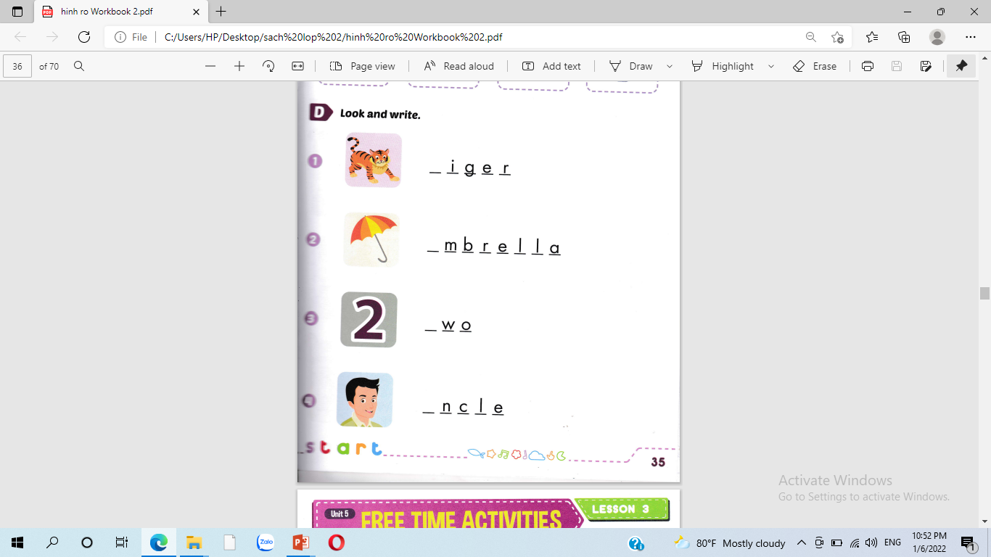
t
u
t
u

Slide 19


Slide 20
1
3
2
4

Slide 21
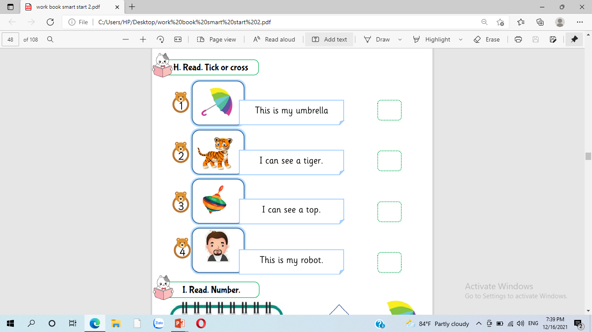


Slide 22






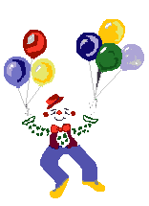
Thank you for enjoying
the lesson !

